Slide 1
Overview of HPC facility –
Clusters & Servers

Slide 2
High Performance Computing
Parallel Computing
Clusters at Computer Division

Slide 3
HPC Definition
High Performance Computing (HPC) most generally refers to the practice of aggregating computing power in a way that delivers much higher performance than one could get out of a typical desktop computer or workstation in order to solve large problems in science, engineering, or business.

Slide 4
Importance of HPC
HPC has had tremendous impact on all areas of computational science and engineering in academia, government, and industry.
Many problems have been solved with HPC techniques that were impossible to solve with individual workstations or personal computers.

Slide 5
Parallel Computer
Parallel computing: the use of multiple computers or processors working together on a common task
Parallel computer: A set of independent processors that can work cooperatively to solve a problem or a computer that contains multiple processors:
each processor works on its section of the problem
processors are allowed to exchange information with other processors
Computing performance is defined in terms FLOPS
Why use parallel computing
Single processor speeds are reaching their ultimate limits
Multi-core processors and multiple processors are the most promising paths to performance improvements

Slide 6
Parallel vs. Serial Computers
Two big advantages of parallel computers:
total performance
total memory
Parallel computers enable us to solve problems that:
benefit from, or require, fast solution
require large amounts of memory
example that requires both: weather forecasting

Slide 7
Parallel computer memory architecture
Shared memory approach
Distributed memory approach
Hybrid distributed shared memory approach

Slide 8
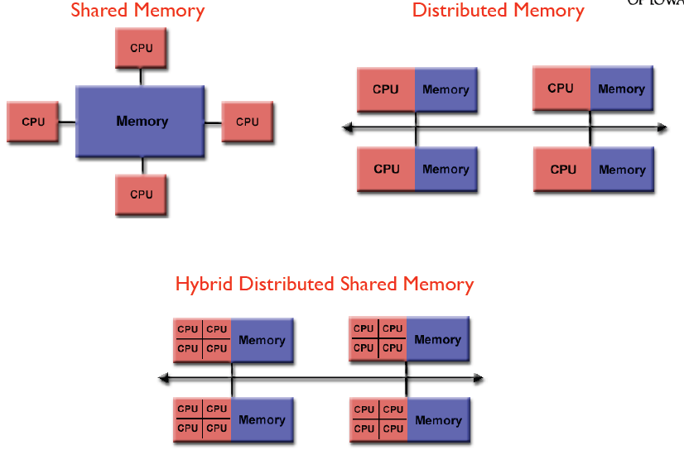
Parallel computer memory architecture

Slide 9
Shared Memory
Shared memory - single address space.
All processors have access to a pool of shared memory.
P
P
P
P
P
P
BUS
Memory

Slide 10
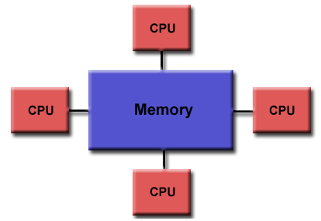
SMP (Symmetric Multi Processing) provides parallel processing by having multiple processors that share a common operating system and memory.
In symmetric (or "tightly coupled") multiprocessing, the processors share memory and the I/O bus or data path. A single copy of the operating system is in charge of all the processors.
SMP, also known as a "shared everything" system, does not usually exceed 16 processors.

Slide 11
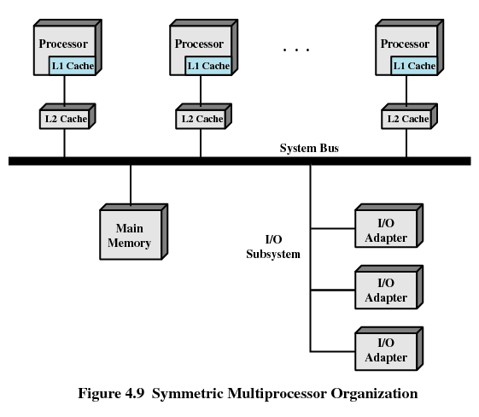
Symmetric Multi Processing Organization

Slide 12
Distributed Memory
Distributed memory - each processor has it’s own local memory.
Must do message passing to exchange data between processors.
P
P
P
P
P
P
M
M
M
M
M
M
Network

Slide 13
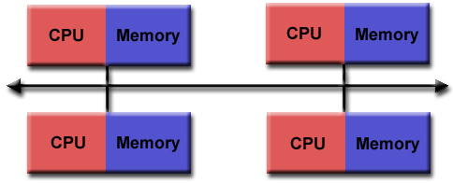
Distributed memory approach
Its a master slave model
The master node divides the work between several slave nodes.
Slave nodes work on their respective tasks.
Slave nodes intercommunicate among themselves if they have to.
Slave nodes return back to the master.
The master node assembles the results, further distributes work, and so on.
Each node has access its own memory so data structures must be duplicated and send over the n/w, leading n/w overhead

Slide 14
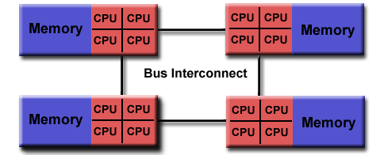
Cluster
A cluster is a type of parallel or distributed processing system, which consists of a collection of interconnected computers (“Loosely Coupled”) working as a single entity (computing resource)
Why Cluster Computing?
One common reason to use cluster computing is a desire to create redundancy in a computing resource and network to ensure that it will always be available and that it will not fail.
Node / Computing System
Node / Computing System
High Speed Network
Node / Computing System
Node / Computing System

Slide 15
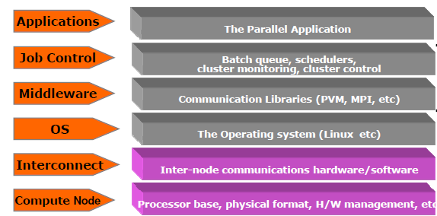
HPC Cluster Stack
Clustering Requirements:
1. Very HP Microprocessors
2. High speed communication
3. Standard tools for parallel / distributed computing

Slide 16
Cluster Components
Nodes
Compute nodes
Master node
I/O node
Login node
Disk array
RAID5, SCSI 320
10k+ RPM, TB+ capacity
NFS / Cluster Supported File system
Networking gear
Infini band, gigE
Switches & Networking cards, Cables
Backup device
AIT3, DLT, LTO
N-slot cartridge drive, SAN
Admin front end
Console (keyboard, monitor, mouse)
KVM switches & cables
Operating system
Red Hat 9+ Linux
Debian Linux
SUSE Linux
Mandrake Linux
FreeBSD and others
MPI
MPICH
LAM/MPI
MPI-GM
MPI Pro
Compilers
gnu
Portland Group
Intel
Scheduler
OpenPBS
PBS Pro
Maui
Hardware
Software

Slide 17
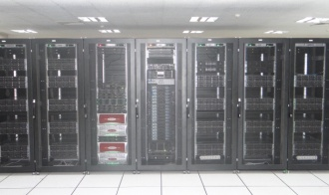
IVY CLUSTER
Configuration | IVY Cluster
Cluster | 400 Node 9600 processors cores
Processor | Dual 12 Core 64 bit Intel Xeon E5-2697 V2 @ 2.7 Ghz 128GB RAM
Performance | 200 Tera FLOPS
Interconnects | Infiniband 256Gbps Two Gigabit Ethernet
Storage | 500 Tera Byte Unified Storage Lustre file system
Backup | Automated Tape Library 8 LTO-6drives

Slide 18
180 Tera Flops
500 TB Luster Storage System
Automated
Tape Library
Login Nodes In
High Availability Mode
OST 500 TB
MDT
Fiber
Channel
400 compute
Nodes
+
2 Gpu Nodes
+
2 Phi Nodes
Login Nodes
Management server
MDS 1
MDS 2
OSS 1&2
OSS 3&4
Administrative Network GigE
Computer Network Infiniband
IPMI Network GigE

Slide 19
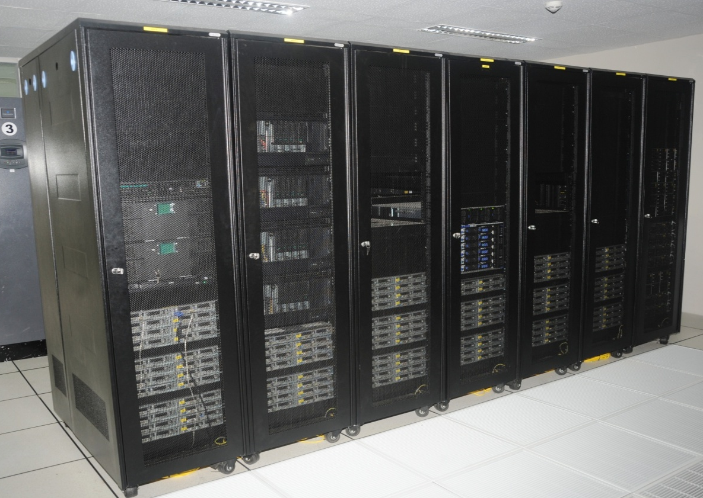
NEHA CLUSTER
Cluster - 134 node, 1608 Processor Cores and 12TB of Memory
Processor - Dual Six Core 64 bit Intel Xeon @ 2.93 Ghz and 48 GB RAM Intel Nehalem Microarchitecture
Performance - system performance of 16.5 Tera FLOPS. SMP Linpack of each node is 131 GFLOPS
Interconnects – Infiniband 4X QDR 40 Gbps networks and two Gigabit Ethernet networks
Storage - 24 Tera Byte Unified Storage using Lustre file system
Backup - Automated Tape Library with 8 LTO-4 drives

Slide 20
2 Master nodes (In high availability mode)
Dual Six Core Intel Xeon 5670 @ 2.93 GHz
48 GB RAM DDR3 @1333 MHz
2*300 GB SATA HDD 10K RPM
4 fat nodes (For Sequential programming)
Dual Six Core Intel Xeon 5680 @ 3.33 GHz
48 GB RAM DDR3 @1333 MHz
2*300 GB SATA HDD 10K RPM
1 management node
Dual Quad Core Intel Xeon 5550 @ 2.65 GHz
16 GB RAM DDR3, 2*300 GB SATA HDD

Slide 21
Storage server details
2 Metadata servers ( In active/passive mode)
Dual Six Core Intel Xeon 5650 @ 2.66 GHz
24 GB RAM DDR3, 2*500 GB SATA HDD 10K RPM
4 Object storage servers ( In active/active mode)
Dual Six Core Intel Xeon 5650 @ 2.66 GHz
24 GB RAM DDR3, 3*500 GB SATA HDD 10K RPM
Network
Gigabit ethernet + Infiniband

Slide 22
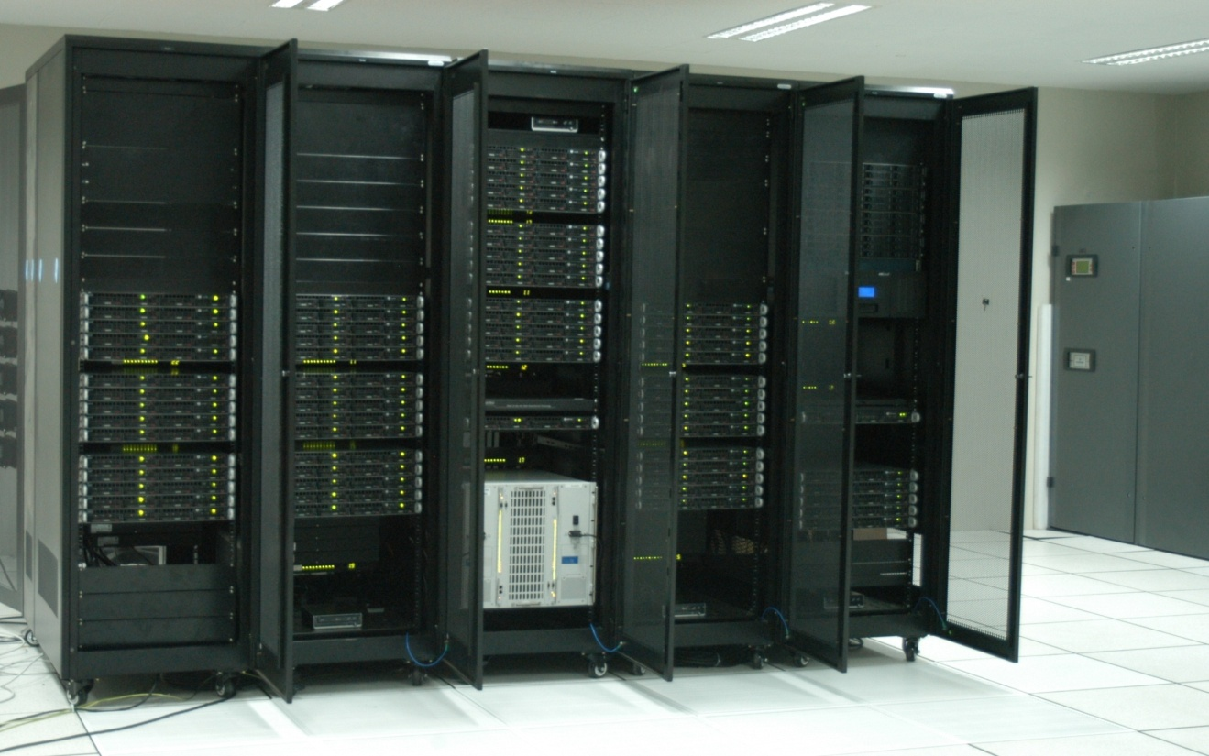
XEON CLUSTER
Cluster - 128 node, 1024 Processor Cores and 2TB of Memory
Processor - Dual Quad Core 64 bit Intel Xeon at 3.16Ghz and 16GB RAM
Performance - system performance of 9.5 Tera FLOPS. SMP Linpack of each node is 81 GFLOPS
Interconnects - Infiniband 144 DDR 4X 20 Gbps networks and two Gigabit Ethernet networks
Storage - 24 Tera Byte Unified Storage & GlusterFS NUFA distributed storage of 20 Tera Byte
Backup - Automated Tape Library with 4 LTO-3 drives and 48 media slots to backup upto 38.4 TB

Slide 24
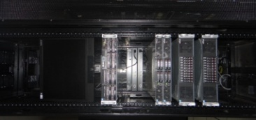
BLADE CLUSTER
Configuration | Blade Cluster (2 Nos)
Cluster | 8 node, 96 Processor core
Processor | Dual Six Core 64 bit Intel Xeon X5675 @ 3.06 Ghz 48 GB RAM
Performance | 1.6 Tera FLOPS
Interconnects | Infiniband 40 Gbps Two Gigabit Ethernet
Storage | 3.6 TB

Slide 25
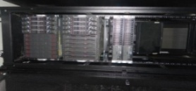
GPU CLUSTER
Configuration | GPU Cluster
Cluster | 4 node 48 Processor core
Processor | Dual Six Core 64 bit Intel Xeon X5675 @ 3.06 Ghz 96 GB RAM
Performance | 2.8 Tera FLOPS
Interconnects | Infiniband 40 Gbps Two Gigabit Ethernet
Storage | 8 TB
Backup | -------

Slide 26
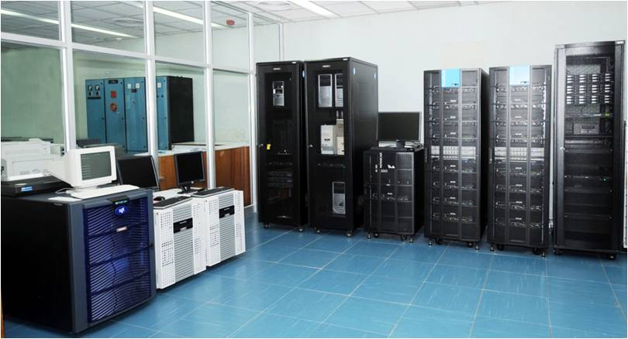
SMP SERVER
Configuration | SMP Servers (3 Nos)
Cluster | 24 Processor core
Processor | 4-socket 6-core Intel Xeon X7460 2.66 GHz 64GB ECC RAM
Performance | 152 GFLOPS
Interconnects | ------
Storage | NAS, 12 TB
Backup | LTO-4 Tape drive

Slide 27
Application Software Details Available at Computer Division
Sl. No. | Name of the Application Software | Category of the Software | Purpose | Users
1 | ABAQUS | Non-linear Finite Element Analysis Software | FBR Design & Analysis | RDG,FRTG,MMG
2 | ANSYS | FEA, Structural Analysis, CFD, Heat Transfer | FBR Design & Analysis | RDG,FRTG,MMG
3 | COMSOL | Multi-Physics Simulation platform | FBR Design & Analysis | FRTG, MC&MFCG, MMG
4 | CFD-ACE, CFD Expert | Computational Fluid Dynamics Software | FBR Design & Analysis | RDG,FRTG,MMG
5 | SYSWELD | Welding and Heat Treatment Simulation Software | Welding Simulation | MMG
6 | THERMOCALC | Computational Thermo Dynamics Software | Thermo Dynamics Calculations and Face diagrams of materials | MMG
7 | VASP | Quantum-mechanical Molecular Dynamics Software | Atomic/Molecular Simulation Studies | MSG, MC&MFCG

Slide 28
Sl. No. | Name of the Application Software | Category of the Software | Purpose | Users
8 | ORCA | Quantum Chemistry Package | Atomic/Molecular Simulation Studies | MC&MFCG
9 | WIEN2K | Molecular Dynamics/DFT Software | Atomic/Molecular Simulation Studies | MC&MFCG,MSG
10 | WRF | Numerical Weather Prediction System | Weather forecasting studies | HSEG
11 | Monte Carlo Codes | Simulation studies based on Mote Carlo Algorithms | Reactor Shielding Calculations | RFG, NSDG(RSDD)
12 | DORT | 2D Transport Code | Reactor Shielding Calculations | NSDG(RSDD)
13 | ATIA DELMIA | Computer Aided 3D Interactive Application | 3D modeling and visualization of FBR/FRFCF plant and PFBR Fuel Handling system | RDG,FRFCF,FRTG
14 | MATHEMATICA | Technical Computing Software for Math applications | General Mathematical Applications | EIG,RDG,FRTG

Slide 29
Thank You

